Slide 1
Electronics dataset
28 Aug 2025

Slide 2
Summary Key Insights
The dataset analysis reveals several key insights into product orders that can guide strategic decisions. Firstly, the classification of products by topics is a strong predictor of product type, with a Predictive Power Index of 89. This suggests that understanding the topic classification can significantly enhance product categorization and inventory management. For instance, the data shows that the price of office equipment is notably higher than that of computing devices, indicating a potential area for pricing strategy adjustments.
Moreover, the analysis highlights that the quantity ordered has a noticeable impact on product distribution. Certain products, such as monitors and desks, show increased percentages in specific quantity categories, suggesting that these products are often ordered in bulk. This insight can be leveraged to optimize stock levels and tailor marketing strategies to target bulk buyers more effectively.

Slide 3
Summary Key Insights
Additionally, while there are no significant trends in price or quantity ordered across the dataset, the data does suggest that grouping by product categories can influence the makeup of quantities ordered. For example, printers and laptops show substantial increases in specific categories, which could inform targeted promotions or bundling strategies. However, it is important to note that some differences in quantities ordered and prices across categories are not statistically significant, indicating the need for further data collection to confirm these patterns.
In conclusion, the dataset provides valuable insights into product categorization, pricing, and ordering patterns. By focusing on topic classification and quantity ordered, businesses can refine their inventory and marketing strategies to better meet customer demands and optimize sales performance. Further statistical testing and data collection are recommended to validate these findings and enhance decision-making processes.

Slide 4
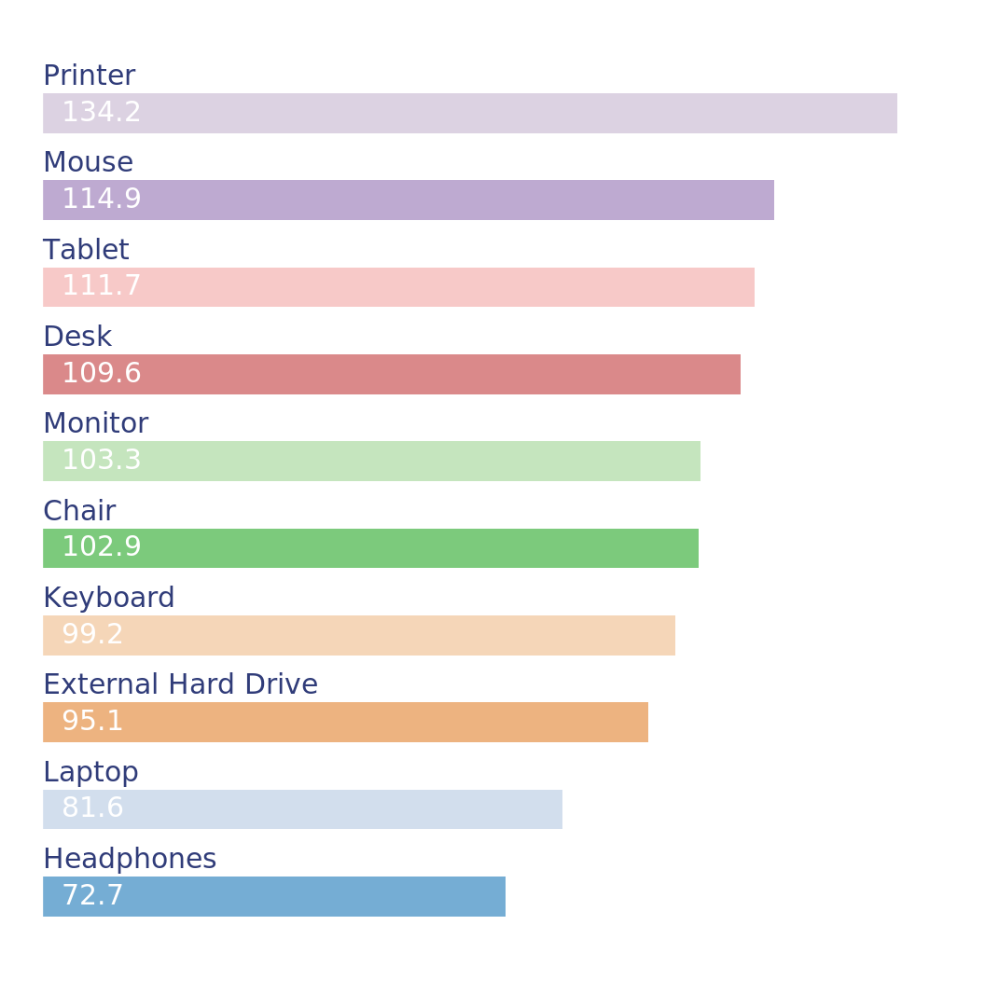
Printer Leads in Average Price Each Among Top 10 Products
Top 10 Products by Average Price Each
Key takeaway: The Printer has the highest price per unit, significantly higher than all other products, indicating it may be a premium product or have higher value features.
The dataset provides information about product orders, including order ID, product name, quantity, price, and order date. The ranking chart shows the aggregated values for each product, focusing on the price per unit. The Printer has the highest price per unit at $134.22, followed by the Mouse at $114.88, and the Tablet at $111.73. The Headphones have the lowest price per unit at $72.68.
Notes:
This bar chart displays the average price for each product, ranked from highest to lowest. The chart includes ten products, with the Printer having the highest average price at $134.22. Following the Printer, the Mouse has an average price of $114.88, and the Tablet has an average price of $111.73. Other products listed include the Desk, Monitor, Chair, Keyboard, External Hard Drive, Laptop, and Headphones, with average prices decreasing in that order. The values represent the average price per unit for each product category, providing a clear comparison of their relative costs.

Slide 5
The statistical test results, specifically Cohens d values, measure the effect size of the average price per unit for each product. The Printer has a Cohens d value of 3.18, indicating a very large effect size and confirming its significantly higher price compared to other products. The Mouse and Tablet also have positive Cohens d values of 1.24 and 0.92, respectively, suggesting they are priced higher than average but not as dramatically as the Printer. On the other hand, products like the Laptop and Headphones have negative Cohens d values of -2.10 and -3.00, respectively, indicating they are priced significantly lower than the average.
In summary, the Printer stands out as the most expensive product by a considerable margin, which could imply it is a high-value item. The Mouse and Tablet are also relatively high-priced, while the Laptop and Headphones are among the least expensive products in the dataset.

Slide 6
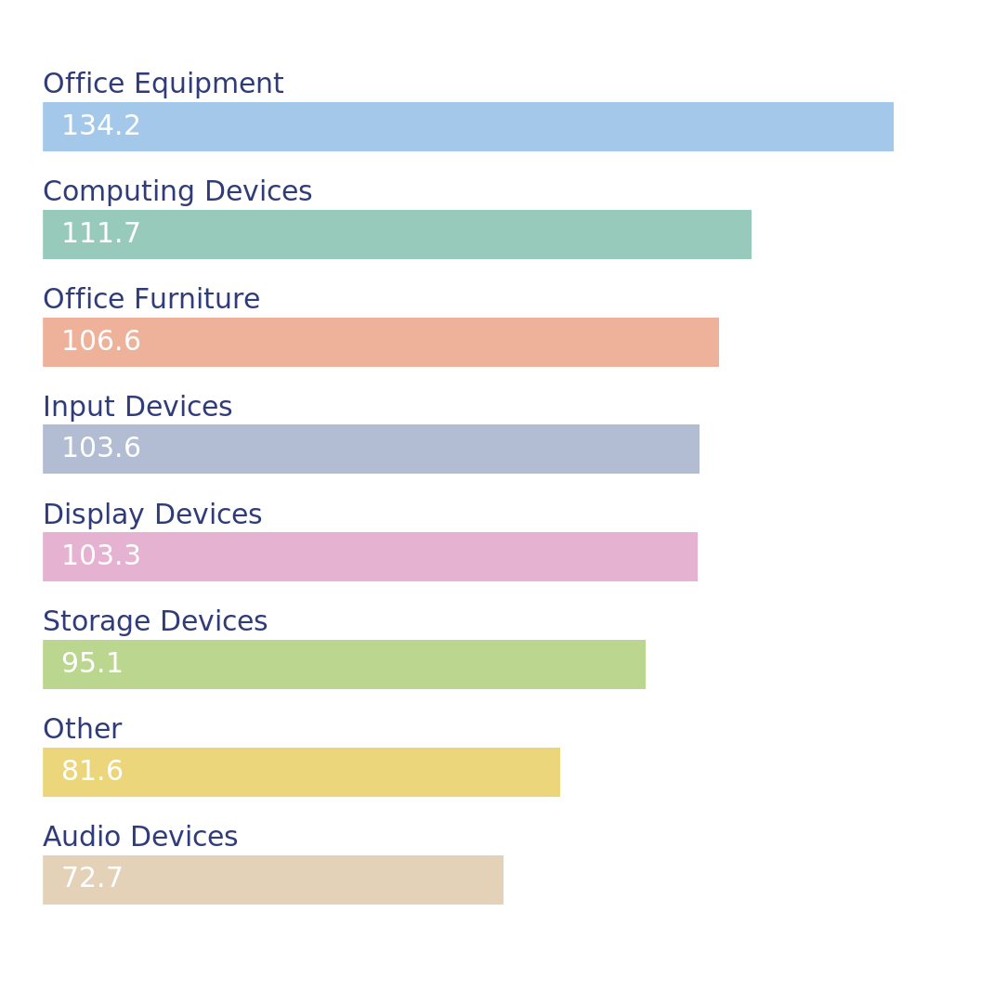
Office Equipment Leads in Average Price Each Among Top 8 Categories
Top eight average values of Price Each by Topics classification for Product

Slide 7
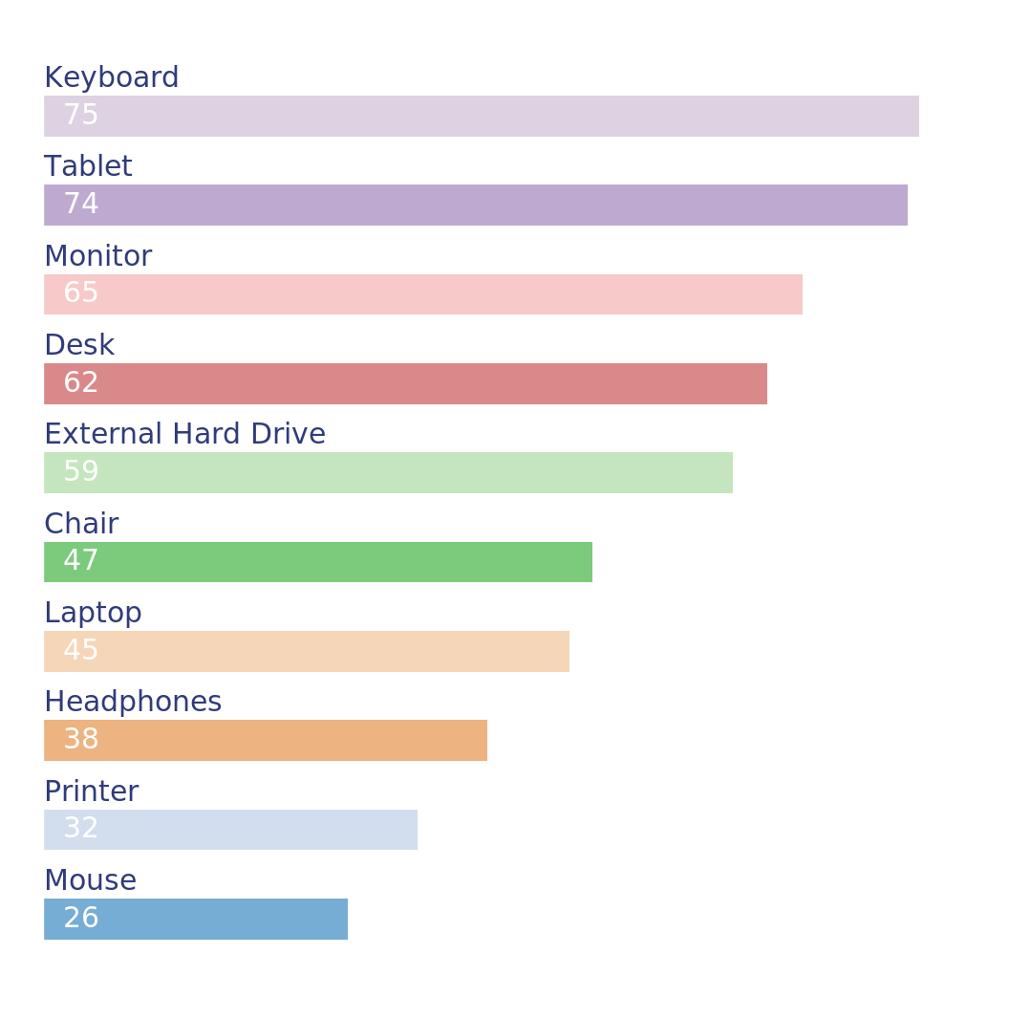
Keyboards and Tablets Lead in Quantity Ordered Rankings
Top 10 Products by Total Quantity Ordered

Slide 8
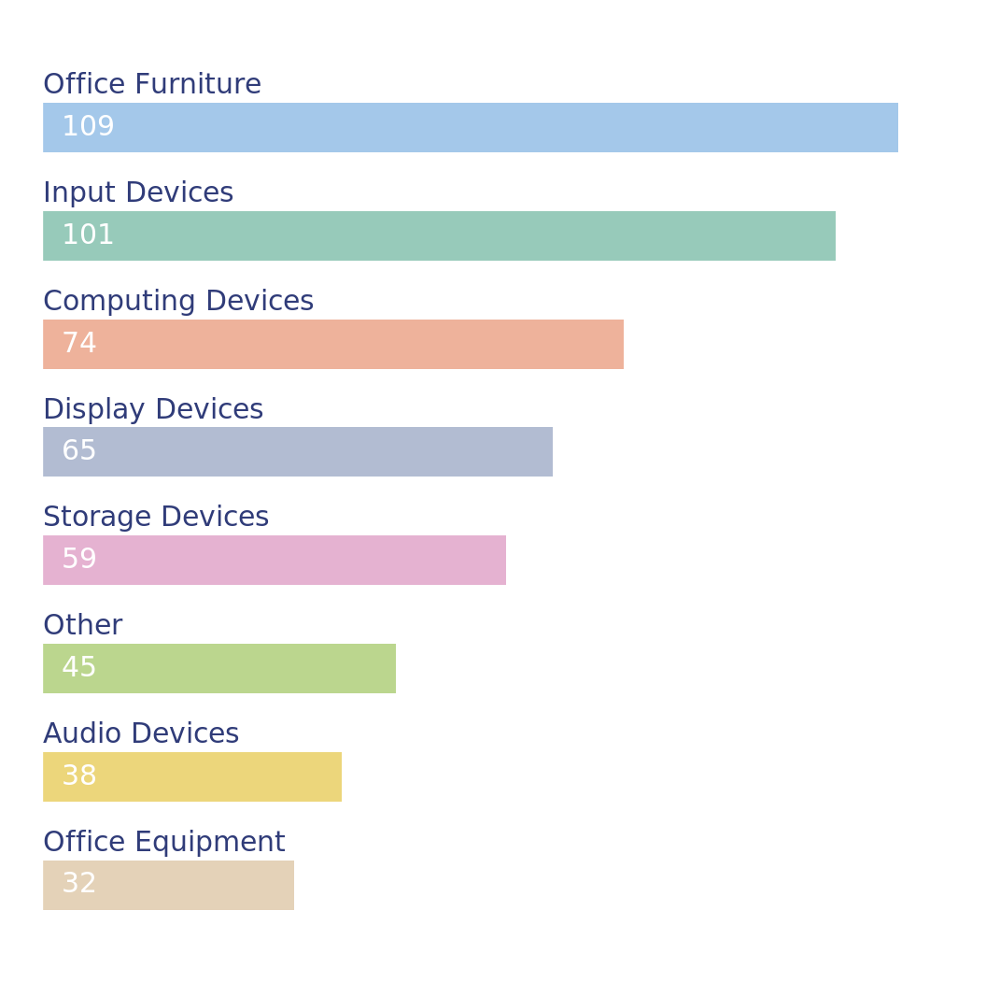
Office Furniture and Input Devices Lead in Quantity Ordered Rankings
Top eight totals of Quantity Ordered by Topics classification

Slide 9
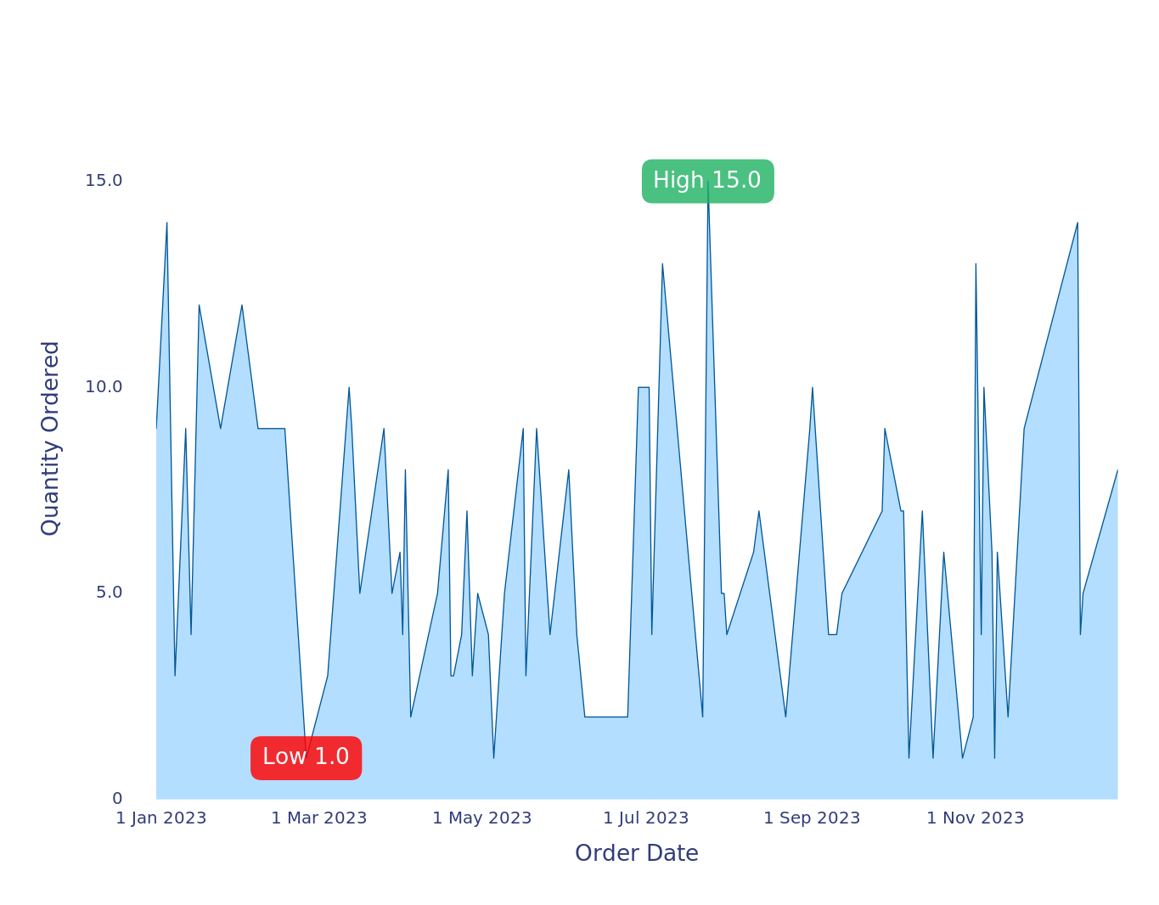
Stable Quantity Ordered from Dec 2022 to Dec 2023
Daily Aggregation of Quantity Ordered from 30 Dec 2022 to 24 Dec 2023

